Slide 1

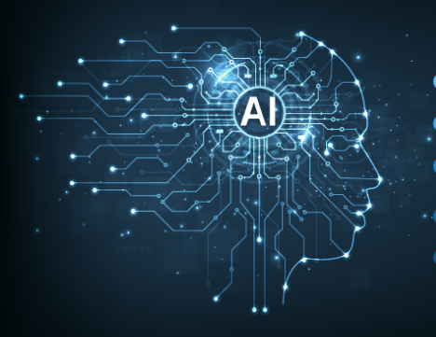
Generative AI
Full Stack Developer

Slide 2
Course D : Agentic AI

Slide 3
02
LangGraph:
Building Advanced Stateful Agent Workflows
Building reliable, stateful, and complex agentic systems with graph-based control.

Slide 4

Agenda
Why LangGraph?
LangGraph Features:
Tool Calling
Message Filtering
What is LangGraph?
Core Component: The Graph
Practice 2 - A "Reflecting" Bot
Core Components:
Graph
State
Nodes
Edges
Other Key Concepts
Summary & Key Takeaways
Compiling & Running the Graph
Practice 1 - A Simple "Echo" Bot

Slide 5




The "Why" - What Problem Does LangGraph Solve?
When you move from a simple "prompt-in, response-out" (like a basic Chain)
to a true "agent," things get complex.
Typical Agent Needs:
Cycles: "If a tool call fails, try again. If the answer isn't good, reflect and retry."
State: "I need to remember the conversation history, what tools I've used, and the user's ultimate goal."
Complex Logic: "Call tool A, then based on its output, either call tool B, tool C, or ask the user for clarification."
Human-in-the-Loop: "Before executing a dangerous action, I must pause and get human approval."
Trying to code this with if/else statements and while loops becomes a "state management nightmare."

Slide 6

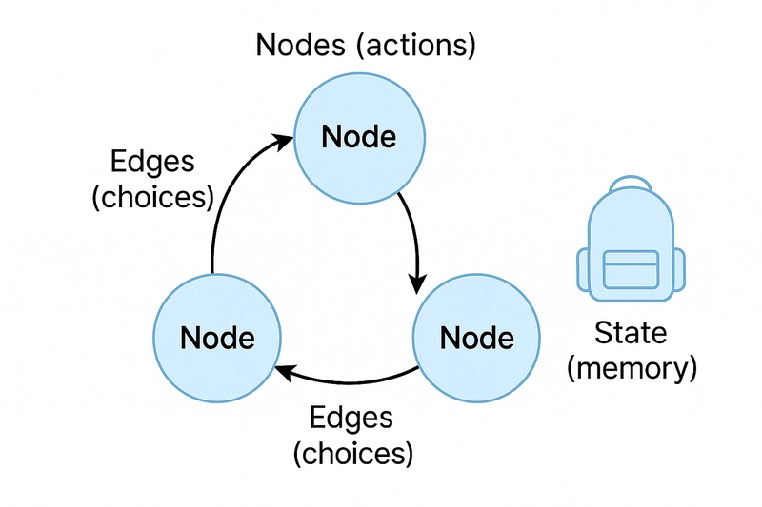
What is LangGraph?
LangGraph is a library for building stateful, multi-actor applications with LLMs.
It extends the LangChain expression language ( LCEL ) with the ability to coordinate multiple chains (or actors) across multiple steps of computation in a cyclic, graph-based way.
Core Idea: Define your agent's workflow as a graph.
Nodes: These are the "workers" (functions or chains).
Edges: These are the "paths" that direct the flow from one node to another.
State: A central object that holds all the information and is passed around, getting updated by each node.

Slide 7
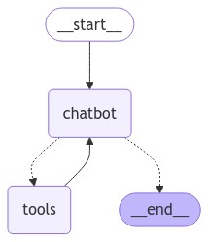
Core Component: The Graph
In LangGraph, you create a StatefulGraph .
This graph is the "blueprint" of your agent's logic.
from langgraph.graph import StateGraph
# The graph object is the "machine"
workflow = StateGraph(StateObject)
You will
Define a "State" object: What information needs to be tracked?
Add "Nodes": What are the steps/functions?
Add "Edges": How do the steps connect?
Compile: Turn the blueprint into a runnable machine.

Slide 8
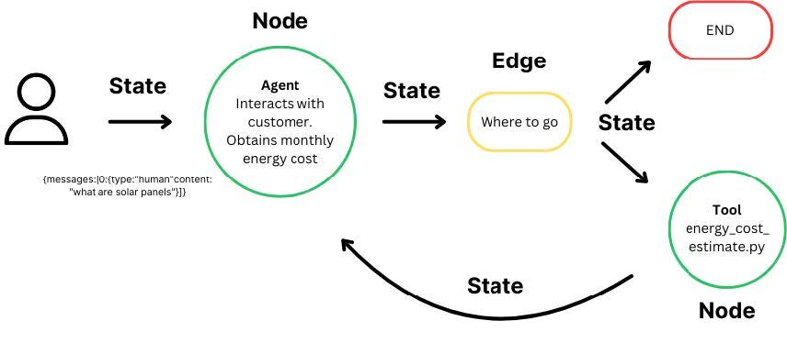
Core Component: State
The State is the most critical concept. It's the memory of your agent. .
It's a TypedDict (a Python dictionary with defined types).
It's passed to every node.
Each node updates the state by returning a dictionary with the keys it wants to change.
LangGraph automatically merges these updates.
from typing import TypedDict, List
from langgraph.graph.message import add_messages
class AgentState(TypedDict):
# 'add_messages' is a special helper to append to the list
# instead of overwriting it.
messages: Annotated[list, add_messages]
# We can also just track simple values
files_processed: List[str]
current_task: str

Slide 9
Core Component: Nodes
A Node is a "step" in your graph. It's just a Python function or a LangChain runnable
(like an LLM chain).
What it does:
1. It receives the current State as its only input.
2. It performs some logic (e.g., call an LLM, run a tool, update a database).
3. It returns a dictionary of the values it wants to update in the State
Example Node:
def my_node(state: AgentState):
print("---EXECUTING MY NODE---")
current_messages = state['messages']
# ... call an LLM or a tool ...
new_message = ("ai", "This is my response!")
# We only return what we want to CHANGE
return { "messages": [new_message] }

Slide 10



Adding Nodes to the Graph
Once you have your State and your node function, you add it to the graph.
# 1. Define the state
class AgentState(TypedDict):
messages: Annotated[list, add_messages]
# 2. Define the node
def call_model(state: AgentState):
response = llm.invoke(state['messages'])
return {"messages": [response]}
# 3. Create graph and add the node
workflow = StateGraph(AgentState)
workflow.add_node("model_caller", call_model)
You also must define an Entry Point. This is the first node to run.
workflow.set_entry_point("model_caller")

Slide 11
Core Component: Edges
An Edge connects two nodes. It defines the path of execution.
There are two types of edges:
1. Normal Edges: Always go from Node A -> Node B
# After 'model_caller' finishes, always go to 'human_input'
workflow.add_edge("model_caller", "human_input")
2. Conditional Edges: Go from Node A -> (Node B or Node C or ...).
It uses a function to check the State and decide which node to go to next.

Slide 12
Feature: Conditional Edges
A conditional edge uses a function that:
Receives the current State .
Returns a string: the name of the next node to run.
def should_we_use_tools(state: AgentState):
last_message = state['messages'][-1]
if last_message.tool_calls:
return "tool_node" # Go to the tool-calling node
else:
return "__end__" # END is a special name to stop the graph
# Now, we add this logic to the graph
workflow.add_conditional_edges(
"model_caller", # The node this decision follows
should_we_use_tools, # The function that makes the decision
{
"tool_node": "tool_node", # If fn returns "tool_node", go to "tool_node"
"__end__": "__end__" # If fn returns "__end__", stop
}
)

Slide 13



Compiling and Running the Graph
Once your nodes and edges are defined, you compile() it into a runnable object.
# 4. Set an entry point
workflow.set_entry_point("model_caller")
# 5. Compile the graph
app = workflow.compile()
# 'invoke' runs the graph from start to finish
final_state = app.invoke({"messages": [("user", "Hello!")]})
# You can also 'stream' it to see each step
for step in app.stream({"messages": [("user", "What's the weather?")]}):
print(step)

Slide 14
Practice 1 - A Simple "Echo" Bot
Goal: Build a simple graph that:
1. Takes a user's message.
2. "Echoes" it back by adding "AI: You said: " to the message.
3. Stops.
You will need to:
1. Define a State (it just needs messages ).
2. Define a node function ( echo_node ) that gets the last message and returns a new AI message.
3. Create a StateGraph.
4. Add your echo_node.
5. Set the entry_point to your echo_node.
6. Add a normal edge from echo_node to __end__.
7. compile() and invoke() it!

Slide 15
Practice 1 - Solution (Part 1: Setup)
import os
from typing import TypedDict, Annotated
from langgraph.graph import StateGraph, END
from langgraph.graph.message import add_messages
# Set up any necessary API keys (if you were calling an LLM)
# os.environ["OPENAI_API_KEY"] = "sk-..."
# 1. Define the State
class EchoState(TypedDict):
messages: Annotated[list, add_messages]
# 2. Define the Node
def echo_node(state: EchoState):
print("---ECHO NODE---")
last_message = state['messages'][-1]
# Our "logic" is just echoing
response_text = f"You said: {last_message.content}"
return {"messages": [("ai", response_text)]}

Slide 16
Practice 1 - Solution (Part 2: Graph)
# 3. Create the graph
workflow = StateGraph(EchoState)
# 4. Add the node
workflow.add_node("echo", echo_node)
# 5. Set the entry point
workflow.set_entry_point("echo")
# 6. Add the edge to stop
# After the 'echo' node runs, always go to the 'END' state.
workflow.add_edge("echo", END)
# 7. Compile
app = workflow.compile()
# --- Run it! ---
print("Running graph...")
final_state = app.invoke({"messages": [("user", "Hello LangGraph!")]})
print("\nFinal State:")
print(final_state['messages'][-1].content)
# Expected Output:
# Running graph...
# ---ECHO NODE---
#
# Final State:
# You said: Hello LangGraph!

Slide 17
Feature: Tool Calling
This is where LangGraph shines. Tool calling is almost always a cycle.
The Flow:
1. Model: LLM is called. It decides to use a tool.
2. Tool Node: A node parses the LLM's request and executes your Python tool function.
3. State Update: The tool's output is added to the messages list (as a ToolMessage ).
4. Loop Back: The graph routes back to the Model node.
5. Model: The LLM now sees its own tool call and the tool's result, so it can formulate a final answer.

Slide 18
Feature: Message Filtering
What if your agent has a very long history, but you only want to send the 5 most recent messages to the LLM to save tokens?
You can "filter" the state that a specific node sees.
When compiling, you can "check-in" and "check-out" keys.
def filter_messages(state: AgentState):
# Only keep the last 5 messages
return state['messages'][-5:]
app = workflow.compile(
# 'checkpointer' is for saving state (persistence)
# 'check_in' modifies the state *before* it's passed to a node
check_in="model_caller", # Only apply this to the 'model_caller' node
# 'mapper' defines the modification
mapper=filter_messages
)

Slide 19
Practice 2 - A "Reflecting" Bot
Goal: Build a bot that "reflects" on its own answer.
1. Node 1 (Generate): Takes user input, generates an answer.
2. Node 2 (Reflect): Looks at the generated answer and "grades" it (e.g., "good" or "bad"). For this
exercise, we'll just randomly choose.
3. Conditional Edge:
If the grade is "good", END the graph.
If the grade is "bad", loop back to Node 1 (Generate) to try again.
Hint: You'll need to add a grade field to your State .

Slide 20
Practice 2 - Solution (Part 1: State & Nodes)
import random
from typing import TypedDict, Annotated
from langgraph.graph import StateGraph, END
from langgraph.graph.message import add_messages
# 1. Define the State (with a new 'grade' field)
class ReflectState(TypedDict):
messages: Annotated[list, add_messages]
grade: str # Our new field]
# 2. Define Nodes
def generate_node(state: ReflectState):
print("---GENERATE NODE---")
# In a real app, you'd call an LLM
# Here, we'll just make a simple response
response_text = f"I'm answering: {state['messages'][-1].content}"
return {"messages": [("ai", response_text)]}
def reflect_node(state: ReflectState):
print("---REFLECT NODE---")
# Randomly "grade" the last AI message
grade = random.choice(["good", "bad"])
print(f"My grade is: {grade}")
return {"grade": grade}

Slide 21
Practice 2 - Solution (Part 2: Graph & Logic)
# 3. Define the conditional logic
def reflection_router(state: ReflectState):
print("---CHECKING GRADE---")
if state['grade'] == "good":
return "__end__"
else:
return "generate" # Loop back to the 'generate' node
# 4. Create and build the graph
workflow = StateGraph(ReflectState)
workflow.add_node("generate", generate_node)
workflow.add_node("reflect", reflect_node)
workflow.set_entry_point("generate")
# After generating, always reflect
workflow.add_edge("generate", "reflect")
# After reflecting, use our conditional logic
workflow.add_conditional_edges(
"reflect",
reflection_router,
{
"__end__": END,
"generate": "generate"
}
)
# 5. Compile and run
app = workflow.compile()
print("---Running Reflective Bot (it might loop!)---")
for step in app.stream({"messages": [("user", "Tell me a fact.")]}):
print(step)
print("----")

Slide 22
Other Key Concepts
Persistence (Checkpointers): LangGraph can automatically save the State to a database (like SQLite, Postgres, Redis) after every step. This lets you "pause" and "resume" agent runs, which is essential for Human-in-the-Loop .
Human-in-the-Loop: You can build a graph that explicitly stops at a node.
1. Agent runs until it hits a pause_node .
2. The State is saved (using a checkpointer).
3. Your UI shows the user: "The agent wants to do X. Approve?"
4. When the user clicks "Approve," you load the graph from that saved state and invoke() it again.

Slide 23
Summary & Next Steps
1. Don't use LangGraph for simple chains. Use LCEL.
2. Use LangGraph for cycles, state, and complex logic. It's for building agents and workflows, not just prompts.
3. State is Everything: Your State object is the "memory" or "blood" of your agent. Define it carefully.
4. Nodes do the work: They are simple functions that receive the state and return updates.
5. Conditional Edges provide the logic: This is how you create loops, branches, and tool-calling abilities.

Slide 24
Q/A

Slide 25
Thanks

